Slide 1

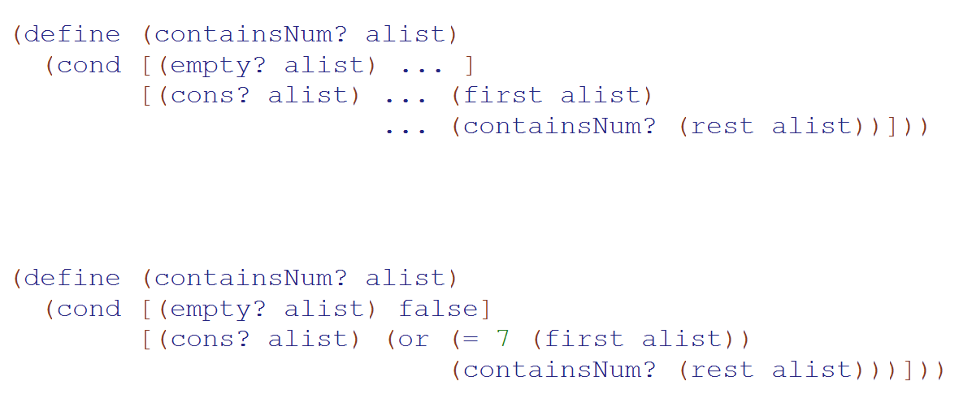
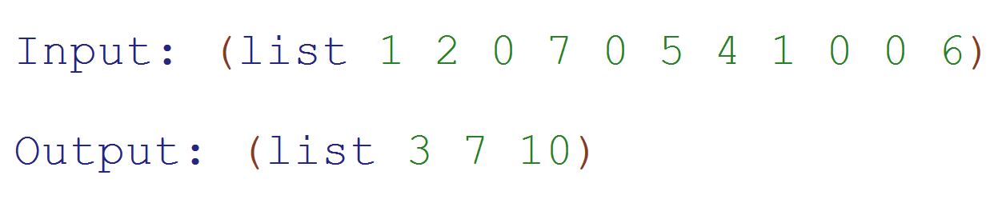
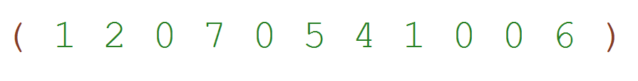
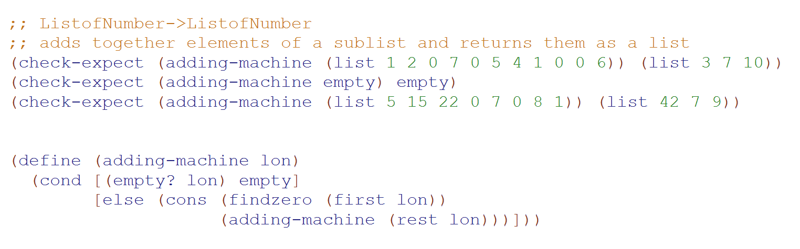
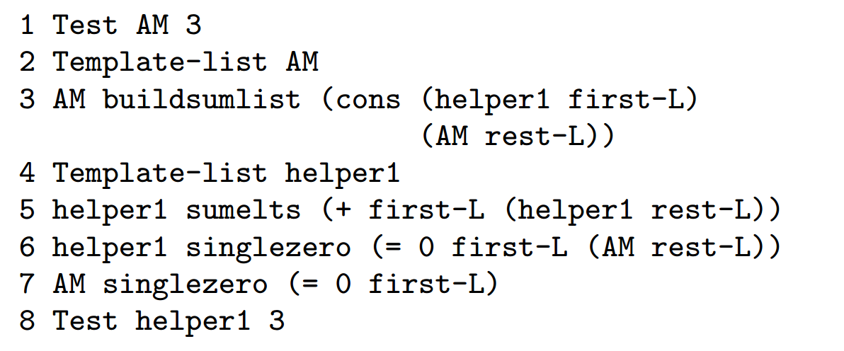
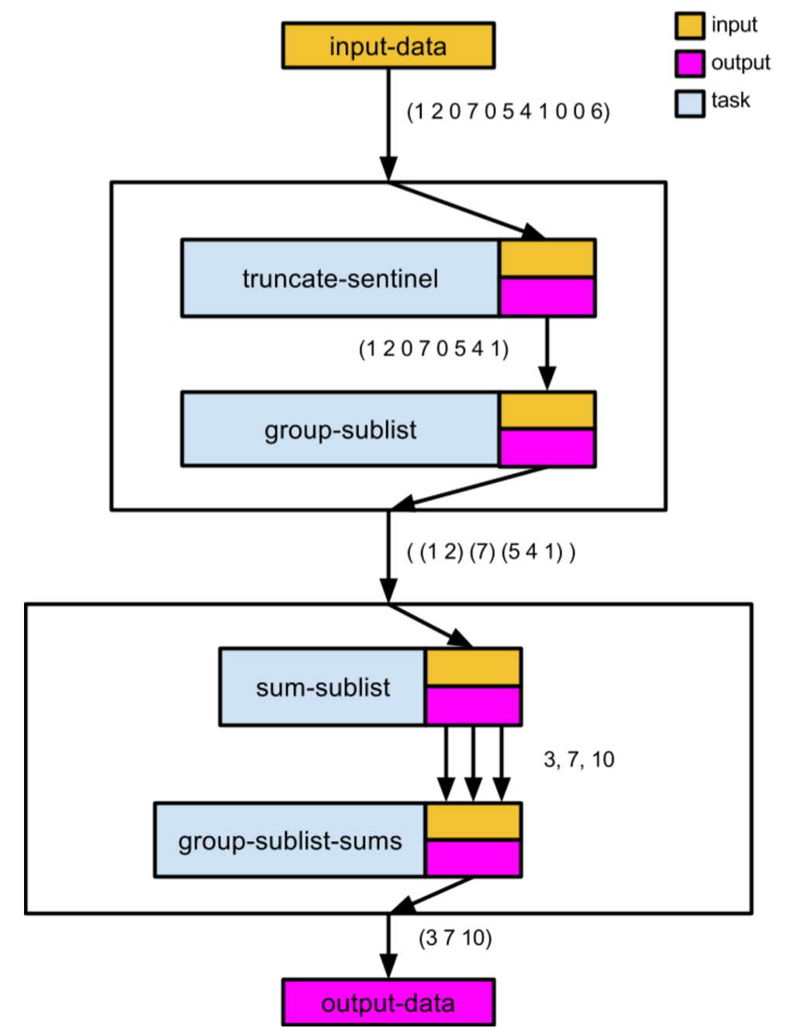
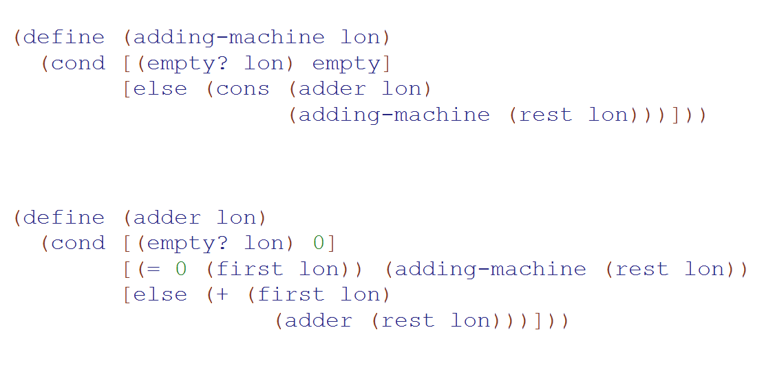
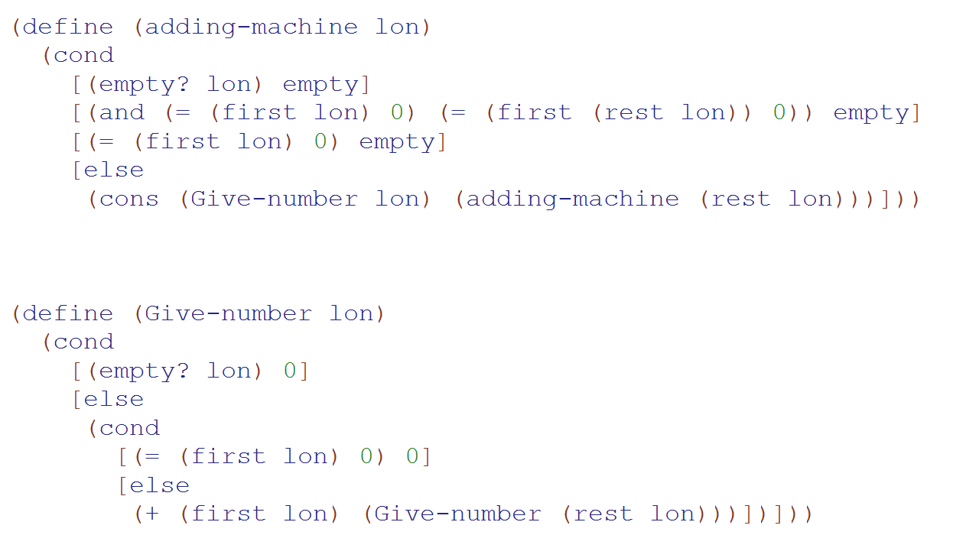
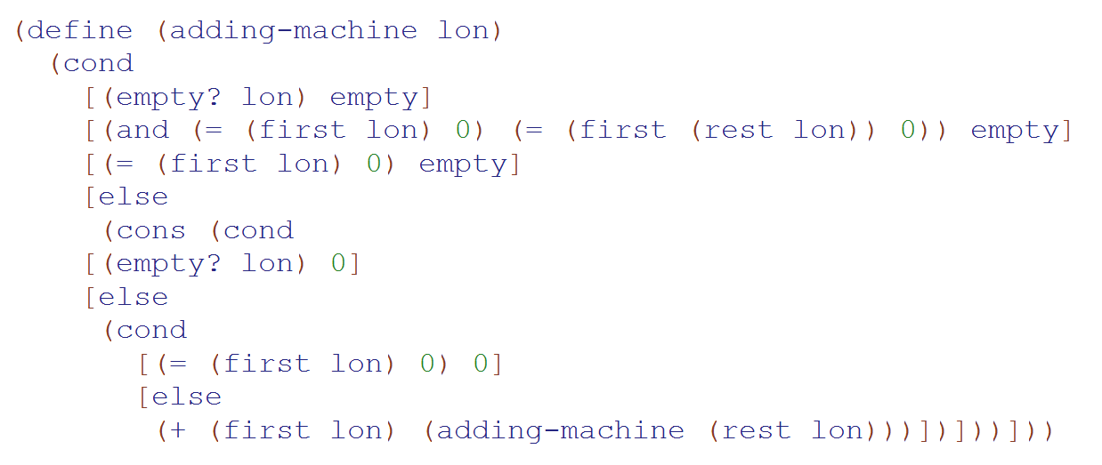
On the Interplay Between Bottom-Up and Datatype-Driven Program Design
Francisco Castro, fgcastro@wpi.edu
Advisor: Kathi Fisler, kfisler@wpi.edu
Department of Computer Science
Abstract
Models of Novice Programmer Behavior
Program Design
When students are faced with a programming problem unlike any they have solved before, prior research suggests that they develop code backwards from essential computations in the problem. Some curricula, however, teach students to first write scaffolding code based on the type of the input data. How do these two approaches interact? We gave CS1 students who were taught to write scaffolding code a programming problem unlike any they had seen before. We found that while students put essential computations into the scaffolds, they often overuse affordances of the scaffolds in ways that lead to plan-composition errors. We propose that steering students away from on-the-fly decomposition while programming could help avoid some of these errors.
Y
Plan Retrieval
Novice retrieves the known solution and implements top-down, with limited adaption to the new problem.
Focal Expansion
Problem:
Determine if a list of numbers contains 7
Know similar solution pattern?
Retrieval
for each num in input_list:
if num == 7:
return True
return False
Plan Creation
Novice creates a new plan starting from a code fragment for a sub-computation (focus/focal computation) and expands
the code around the focus bottom-up to implement a solution.
N
Creation
Novices rely heavily on previously learned program plans, examples, or solutions, fitting learned solutions into the context of new problems [2,4]
The focal expansion model identifies the states of (1) plan retrieval and (2) plan creation to describe novice programmer behavior when encountering a programming problem [3]
Datatype-Driven
How to Design Programs (HTDP) Core Idea:
Design programs from the structure of the input data
Methodology
Problem: Adding Machine
Design a program called adding-machine that consumes a list of numbers and produces a list of the sums of each non-empty sublist separated by zeros. Ignore input elements that occur after the occurrence of two consecutive zeros.
Key Takeaways
Research Questions
When do HTDP-trained students use templates?
How do focal computations manifest in HTDP programs?
How and when do HTDP students integrate focal computations into existing code?
Data suggests that students largely work through problem tasks
Students retrieved plans in the form of (a) operational expressions and (b) entire functions
Key issues: on-the-fly problem decomposition around existing code and the retrieval of contexts that aren’t well suited to the problem
Students struggled to decompose the problem and compose plans – they were not taught a systematic process for doing these
identify sublists
ignore
sum
Data Collection
Spring 2015 CS1 course using HTDP in Racket
Participants worked on the Adding Machine problem during a weekly lab session
Video captured activity within the IDE window
25 (of 138) submissions analyzed
Data Coding
build output list
Future Work
Develop pedagogical interventions that teach principles of problem decomposition and plan composition
Use concrete examples to work out problem decompositions
Teach data-centric principles for programming – i.e. data transformation to make subsequent computations easier; plan dependencies to work out plan composition
Results
helper function
build list
Output: number
double zero
single zero
Output:
list
build list
sum
single zero
Output: number
References
sum
[1] M. Felleisen, R. B. Findler, M. Flatt, and S. Krishnamurthi. How to Design Programs. MIT Press, 2001.
[2] P. L. Pirolli and J. R. Anderson. The role of learning from examples in the acquisition of recursive
programming skills. Canadian Journal of Psychology, 39(2):240–272, 1985.
[3] R. S. Rist. Knowledge creation and retrieval in program design: A comparison of novice and
intermediate student programmers. Hum.-Comput. Interact., 6(1):1–46, Mar 1991.
[4] J. C. Spohrer and E. Soloway. Novice mistakes: Are the folk wisdoms correct? Commun. ACM,
29(7):624–632, July 1986.
double zero
Findings
Evidence of HTDP template use, development of focals, and task decomposition
Students created helpers but failed to use them to effectively decompose the problem, attempting various task combinations and replicating tasks within and across functions
Students struggled with problem decomposition and plan composition, resulting in output inconsistencies and errors
build list
Output:
list
single zero
sum
Acknowledgments
Output: number
We thank Joe Beck for letting us collect data in his course and Mike Clancy for pointing us to the Adding Machine problem. This research is partially funded by the US NSF under grant number CCF1116539.

